Slide 1
Finite State Machines 16th -17th December 2024
By: PRIYANKA C
Application Engineer

Slide 2
Contents
Introduction to FSM
Types of FSM
FSM design process
Practical Applications
Examples

Slide 3
Introduction to FSM
What , Why and How?

Slide 4
What is FSM?
“FSM is a mathematical model that is used to design systems that transition between finite states based on inputs”
It consists of finite number of states, hence the name.
A set of states, a set of input events, a set of output actions or reactions, and a set of state transitions based on input events forms the fundamental components of an FSM.
Example : Robot ---Idle, Moving, Cleaning etc

Slide 5
Components of FSM?
States → represents systems different conditions .
example: Traffic lights can be Red, Green and Yellow
Inputs → External signals that causes transitions between states
example: sensors or timer
Transitions→ Rules /Conditions for moving between states
example: After Red, move to Yellow then move to Green
Outputs → Signals generated based on current state
example: which light is on at the time(Red, Yellow or Green)
Clock → that helps in synchronizing states

Slide 6
Why do we need FSM?
Finite State Machines (FSMs) are critically important because they provide a structured way to model and control the sequential behavior of digital systems.
1. Controls Logic in Sequential Systems
→Essential for managing state-based operations.
→Example: Processor instruction decoding.
2. Simplifies Complex System Design
→Breaks large systems into smaller, manageable states.
→ Example: UART protocol state machine.
3. Critical in VLSI SoC Design
Drives efficiency, reliability, and modularity.
Example: Communication Protocols (UART, I2C, SPI).
4. Deterministic and Predictable Behaviour
→ Outputs and transitions are well-defined for any given input.

Slide 7
Types of FSM
Deterministic FSM
In a deterministic FSM, the next state is uniquely defined by the current state and the input.
This means that for any given input and current state, there is only one possible transition to the next state.
Example: Traffic Light Controller
Non-Deterministic FSM
Non-deterministic FSMs allow for multiple possible transitions from the same state, based on the same input.
This means the machine can simultaneously exist in more than one state.
Example: Elevator System

Slide 8
Types of FSM
Mealy FSM
A Mealy machine produces outputs that depend on both the current state and the current input.
The output is generated during a state transition, making it more responsive to changes in the input.
Example: Temperature control system, coin operated turnstile
Moore FSM
In Moore machine, the outputs depend only on the current state.
Regardless of the inputs, the output is fixed for a given state.
Transitions between states are still triggered by inputs, but the outputs are tied to the state itself.
Example: Washing Machine controller

Slide 9
Moore FSM
Input
Combinational Logic circuit
Memory Element
output

Slide 10
Moore FSM State Machine
0
1
1
00/1
01/1
1
0
0
10/0
11/0
0
1

Slide 11
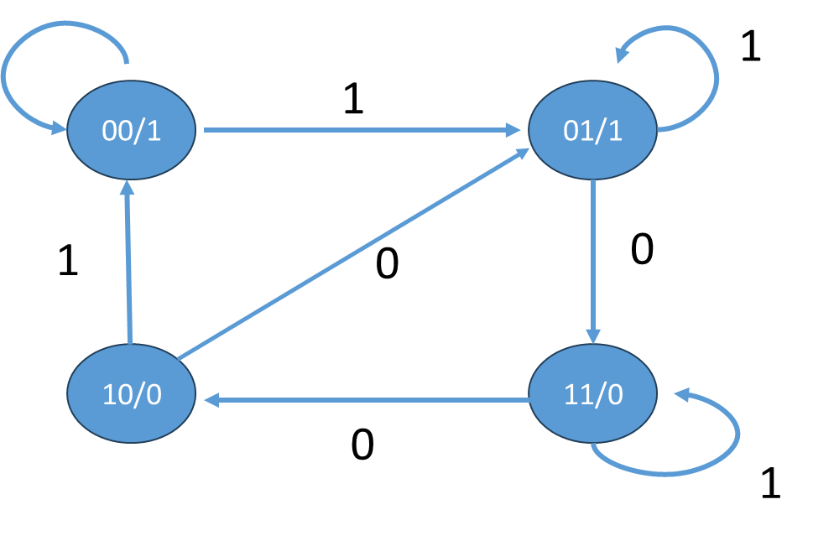
Moore Machine State Table
Input |  | PS |  |  | NS |  |  | Output
X |  | Q1 | Q0 |  | Q1 | Q0 |  | Y
0 |  | 0 | 0 |  | 0 | 0 |  | 1
0 |  | 0 | 1 |  | 1 | 1 |  | 0
0 |  | 1 | 0 |  | 0 | 1 |  | 1
0 |  | 1 | 1 |  | 1 | 0 |  | 0
1 |  | 0 | 0 |  | 0 | 1 |  | 1
1 |  | 0 | 1 |  | 0 | 1 |  | 1
1 |  | 1 | 0 |  | 0 | 0 |  | 1
1 |  | 1 | 1 |  | 1 | 1 |  | 0

Slide 12
Moore Machine State Equations
Q1Q0
Input |  | PS |  |  | NS |  |  | Output
X |  | Q1 | Q0 |  | Q1 | Q0 |  | Y
0 |  | 0 | 0 |  | 0 | 0 |  | 1
0 |  | 0 | 1 |  | 1 | 1 |  | 0
0 |  | 1 | 0 |  | 0 | 1 |  | 1
0 |  | 1 | 1 |  | 1 | 0 |  | 0
1 |  | 0 | 0 |  | 0 | 1 |  | 1
1 |  | 0 | 1 |  | 0 | 1 |  | 1
1 |  | 1 | 0 |  | 0 | 0 |  | 1
1 |  | 1 | 1 |  | 1 | 1 |  | 0
X
00
01
11
10
0
0
1
1
0
1
0
0
1
0
Q1’ = X’ Q0 + Q1 Q0
Q1Q0
X
00
01
11
10
0
1
0
0
1
Q1Q0
1
1
1
0
1
X
00
01
11
10
0
0
1
0
1
Y = Q0’ + X Q1’
1
1
1
1
0
Q0’ = Q1’ + X Q0

Slide 13
Mealy FSM
Input
Combinational Logic circuit
output
Memory Element

Slide 14
Mealy FSM State Machine
0/1
1/0
1/0
00
01
1/1
0/0
0/1
10
11
0/0
1/1

Slide 15
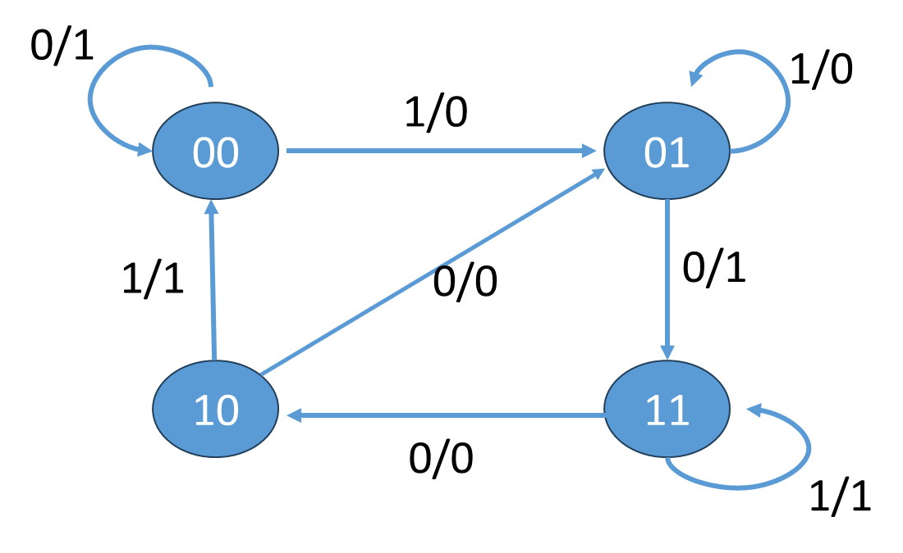
Mealy Machine State Table
Input |  | PS |  |  | NS |  |  | Output
X |  | Q1 | Q0 |  | Q1 | Q0 |  | Y
0 |  | 0 | 0 |  | 0 | 0 |  | 1
0 |  | 0 | 1 |  | 1 | 1 |  | 1
0 |  | 1 | 0 |  | 0 | 1 |  | 0
0 |  | 1 | 1 |  | 1 | 0 |  | 0
1 |  | 0 | 0 |  | 0 | 1 |  | 0
1 |  | 0 | 1 |  | 0 | 1 |  | 0
1 |  | 1 | 0 |  | 0 | 0 |  | 1
1 |  | 1 | 1 |  | 1 | 1 |  | 1

Slide 16
Mealy Machine State Equations
Q1Q0
Input |  | PS |  |  | NS |  |  | Output
X |  | Q1 | Q0 |  | Q1 | Q0 |  | Y
0 |  | 0 | 0 |  | 0 | 0 |  | 1
0 |  | 0 | 1 |  | 1 | 1 |  | 1
0 |  | 1 | 0 |  | 0 | 1 |  | 1
0 |  | 1 | 1 |  | 1 | 0 |  | 0
1 |  | 0 | 0 |  | 0 | 1 |  | 0
1 |  | 0 | 1 |  | 0 | 1 |  | 0
1 |  | 1 | 0 |  | 0 | 0 |  | 1
1 |  | 1 | 1 |  | 1 | 1 |  | 1
X
00
01
11
10
0
0
1
1
0
1
0
0
1
0
Q1’ =
Q1Q0
X
00
01
11
10
0
1
0
0
1
Q1Q0
1
1
1
0
1
X
00
01
11
10
0
0
1
0
1
Y =
1
1
1
1
0
Q0’ =

Slide 17
Differences between Mealy and Moore Machine
Mealy Machine :
Output depends on both the current state and input.
Outputs can change immediately with input changes.
State transitions are determined by inputs and state.
Typically more complex due to dependency on both state and input for output.
Can respond faster because the output is based on input, reducing delays.
Requires additional logic for output generation based on inputs and states.
Moore Machine :
Output depends only on the current state.
Outputs change only on state transitions
State transitions are determined only by the current state.
Simpler because outputs depend only on the state.
May have slower response time since the output only changes on state transitions.
Easier to implement as outputs are directly linked to the state.

Slide 18
Applications of FSM
Processors: Instruction decoders, ALU controllers, pipeline stages.
Controllers: Memory controllers, DMA controllers, clock controllers.
Communication Protocols: UART, AXI, SPI, I2C controllers.
Error Control: CRCs, ECC circuits, and state-based error recovery mechanisms.
Interface Logic: Handshaking protocols in bus systems.
State Machines in FPGAs: Implementing sequential circuits on FPGAs using FSMs.

Slide 19
Design Flow of FSM
Define system requirements -- states and Transitions
Create state transition table or diagram
Choose the state encoding –one-hot, binary, gray
Initialize the FSM
Process input events
Check the current state and input event
Execute transition
Update current state

Slide 20
FSM for Sequential Circuits
D Flip-flop
FF
Output
D | Q | Qn+1
0 | 0 | 0
0 | 1 | 0
1 | 0 | 1
1 | 1 | 1
Input
D
Q
Clk
Q`
1
S0/0
S1/1
0
1
0

Slide 21
FSM for Sequential Circuits
T Flip-flop
FF
Output
T | Q | Qn+1
0 | 0 | 0
0 | 1 | 1
1 | 0 | 1
1 | 1 | 0
Input
T
Q
Clk
Q`
1
S0/0
S1/1
0
0
1

Slide 22
FSM for Sequential Circuits
JK Flip-flop
FF
Output
Input
J
Q
J | K | Q | Qn+1
0 | 0 | 0 | 0
0 | 0 | 1 | 1
0 | 1 | 0 | 0
0 | 1 | 1 | 0
1 | 0 | 0 | 1
1 | 0 | 1 | 1
1 | 1 | 0 | 1
1 | 1 | 1 | 0
Clk
Input
K
Q`
1,0
1,1
S0/0
S1/1
0,0
0,1
0,0
1,0
0,1
1,1

Slide 23
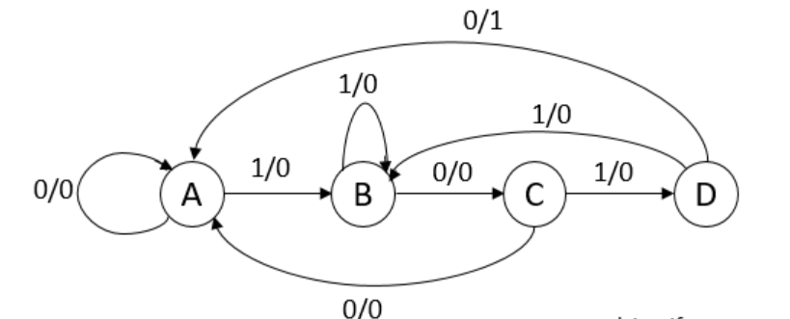
Sequence Detector - 1010
Mealy Machine
Non-Overlapping Sequence Detector
----- once the sequence is started, the detector resets and starts from beginning to find new sequence

Slide 24
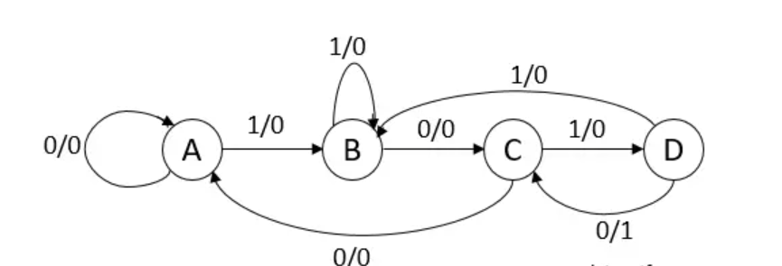
Sequence Detector – 1010
Mealy Machine
Overlapping Sequence Detector
----- Last few bits of the sequence can be the start of another sequence

Slide 25
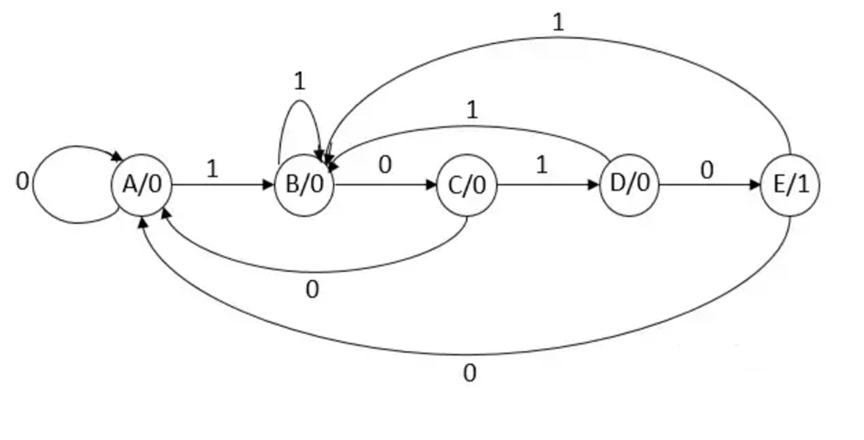
Sequence Detector – 1010
Moore Machine
Non-Overlapping Sequence Detector
----- once the sequence is started, the detector resets and starts from beginning to find new sequence

Slide 26
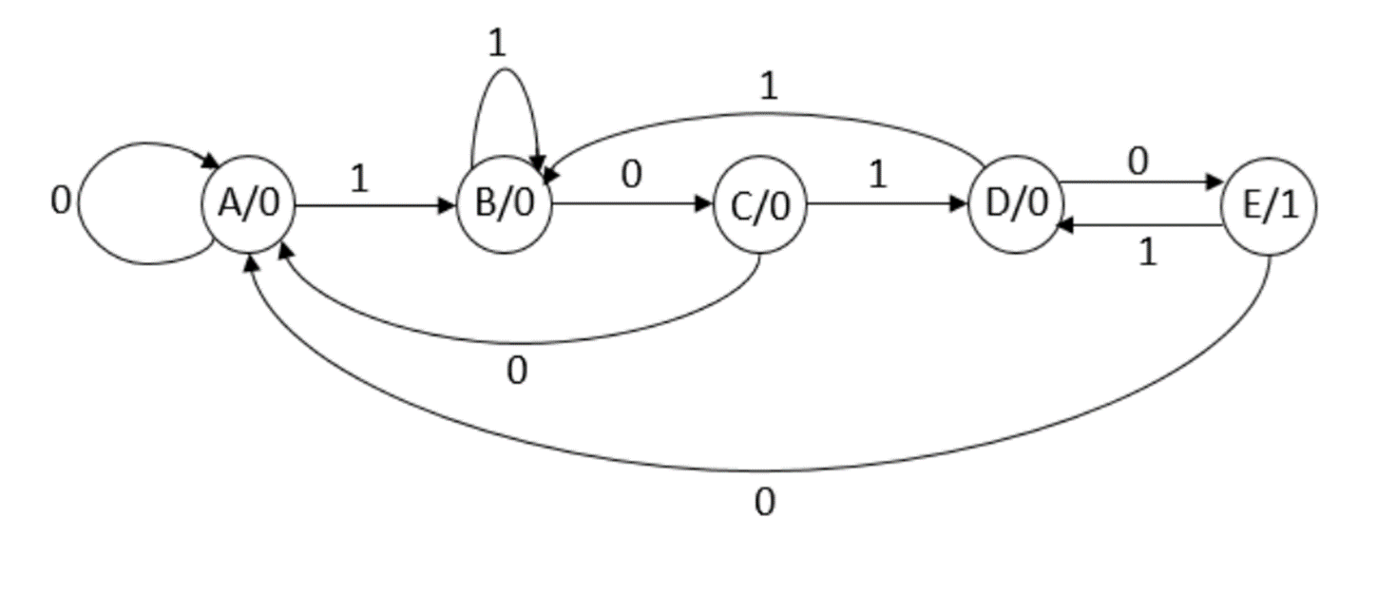
Sequence Detector – 1010
Moore Machine
Overlapping Sequence Detector
----- Last few bits of the sequence can be the start of another sequence

Slide 27
Assignment 1
Derive the state diagram for an FSM that has an input w and an output z. The machine has to generate z = 1 when the previous four values of w were 1001 or 1111; otherwise, z = 0. Overlapping input patterns are allowed.
An example of the desired behavior is
w: 010111100110011111
z: 000000100100010011
Write a Verilog RTL code and verify the same.

Slide 28
Assignment 2
A sequential circuit has two inputs, w1 and w2, and an output, z. Its function is to compare the input sequences on the two inputs. If w 1=w2 during any four consecutive clock cycles, the circuit produces z = 1 otherwise, z = 0.
For example
w1:0110111000110
w2:1110101000111
z: 0000100001110
Write a Verilog RTL code and verify the same.

Slide 29
Assignment 3
Design the FSM controller for the traffic lights at an intersection (North/ South (NS) vs. East/West (EW) with green and red lights only.
The rule:
(a) if no car detected, stay the same state,
(b) if cars are detected in the direction with red light (independent of whether cars are detected in the direction with green light), switch state.
Design the circuit using JK-FF.
Write a Verilog RTL code and verify the same.

Slide 30
Assignment 4
A serial adder receives two operands A = an-1,..., a,... a0 and B = bn-1,..., bi,... bo as two sequences of bits (i = 0, 1,..., n-1) and adds them one bit at a time to generate the sequence of bits s of the sum as the output.
Implement this serial adder as a finite state machine.
Design the circuit using D-FF.
Write a Verilog RTL code and verify the same.

Slide 31
References
1. “Digital Design” by M. Morris Mano

Slide 32
Thank You

